Slide 1
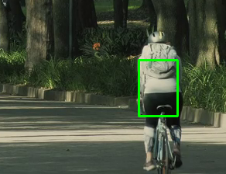
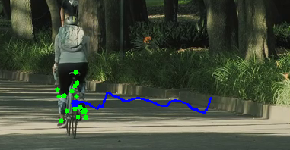
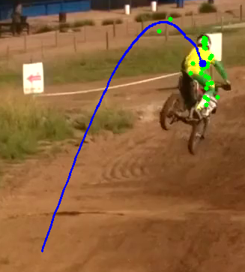
Real-Time Object Tracking and Trajectory Mapping using Sparse Optical Flow
The Challenge: Tracking dynamic Objects is difficult due to noise, motion and occlusions.
The Goal: Develop a robust pipeline using classical techniques for stable trajectory smoothing.

Slide 2
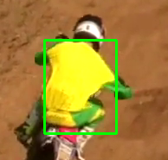
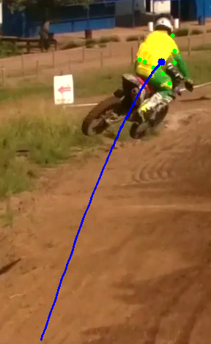
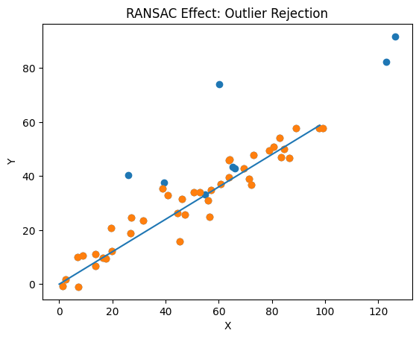
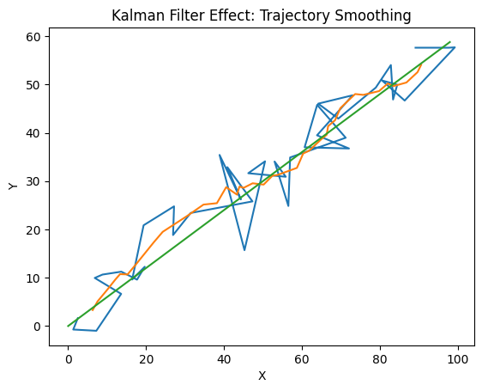
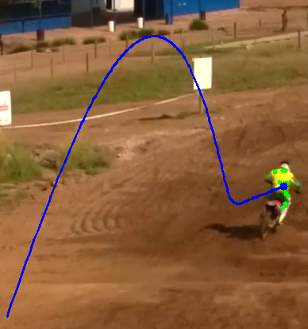
Methodology: A multi-stage Tracking Pipeline
1. Initialization (Frame 1)
Action: User Selects an object by drawing rectangle upon it. Technique: Feature Detection by shi-Tomasi Code Match: cv2.goodFeaturesToTrack(old_gray, mask=roi_mask, **feature_params)
2. Motion Estimation
Action: Calculate Feature Motion Technique: Pyramidal Lucas-Kanade Optical flow Code Match: p1, status, err = cv2.calcOpticalFlowPyrLK(old_gray, frame_gray, p0, None, **lk_params)
3. Outlier Rejection
Action: Find motion model, Rejects points that don’t follow majority motion. Technique: RANSAC Code Match: M, mask_ransac = cv2.findHomography(good_old, good_new, cv2.RANSAC, 5.0)
4. Trajectory Smoothing
Action: Predict next position, Smooths jitter Technique: Kalman Filter Code Match: [x, y, vx, vy]
5. Final Visualization
Action: Draw stable object center and path. Technique: Average, Mean Code Match: cx, cy = np.mean(clean_new, axis=0)

Slide 3
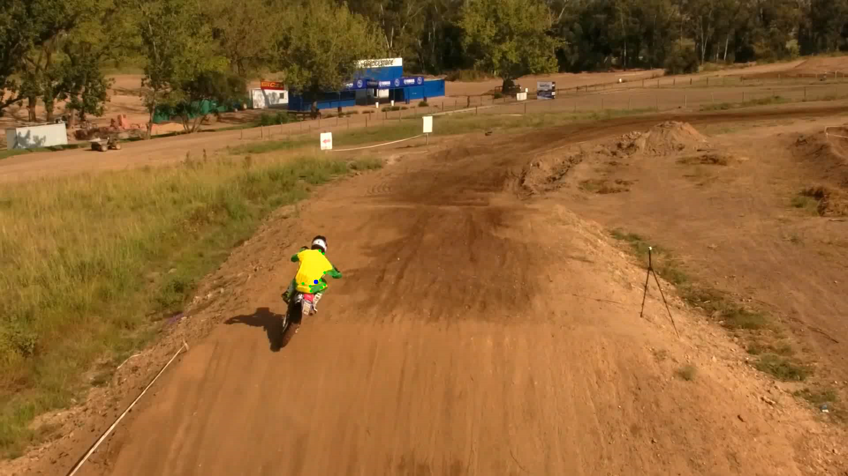
Final Result

